Slide 1



Azure Cosmos DB web apps with Node.js and TypeScript
Chris Joakim, Microsoft, Cosmos DB Global Black Belt (GBB)
https://www.linkedin.com/in/chris-joakim-4859b89

Slide 2
Presentation Outline
Meet Chris
Meet Azure Cosmos DB
The Azure Cosmos DB JavaScript/TypeScript SDK
Why TypeScript?
The azu-js Package @ NPM
The TypeScript/Express/Cosmos DB Web Application - code walkthrough and demo
Summary

Slide 3
Meet Chris
2021 - Microsoft - Cosmos DB Global Black Belt (GBB)
2016 - Microsoft - Cloud Solution Architect
1986 - 2016 - Software Developer, CTO, Owner
Languages: COBOL -> Smalltalk -> Java -> Ruby on Rails (RoR) -> Node.js (MEAN) -> Python -> TypeScript. Used CoffeeScript with RoR and MEAN stacks.
Databases: IMS/DB, Relational (DB2, MySQL, PostgreSQL), MongoDB (2008), -> Cosmos DB (2017)
Preferences: Dynamic Languages and Schemaless JSON-based NoSQL
Davidson/Charlotte, NC, USA
LinkedIn: https://www.linkedin.com/in/chris-joakim-4859b89/
GitHub: https://github.com/cjoakim
Why did I Highlight CoffeeScript and MongoDB & Cosmos DB?

Slide 4
Meet Azure Cosmos DB
Cloud-Native family of NoSQL Databases
Born in the cloud
High Performance – single-digit ms queries
High Availability – multiple copies of your data, 99.99 to 99.999% SLA
Globally Replicated, on the high-speed Azure fiber network
APIs: NoSQL, Mongo, Mongo vCore, Cassandra, Cassandra MI, Gremlin
Dynamic Throughput Model with Request Units (RUs)
Enables you to “right size” your Cosmos DB account and costs
NoSQL API stores JSON Documents, but uses SQL for queries
Enables high-performance “end-to-end JSON” applications
Change-Feed for “event driven” apps with serverless Azure Functions
Synapse Link for analytics and batch
https://learn.microsoft.com/en-us/azure/cosmos-db/

Slide 5
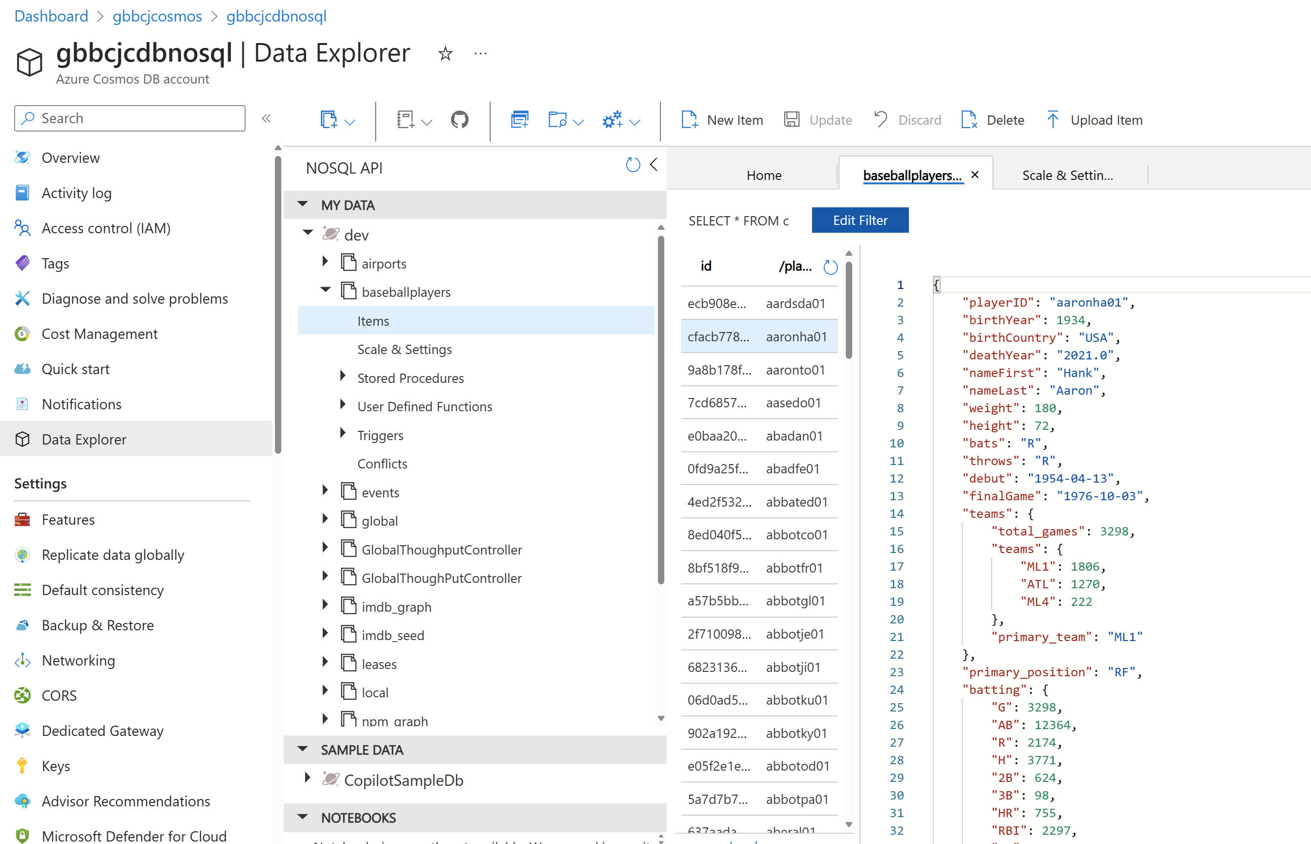
Azure Cosmos DB : Data Explorer in Azure Portal

Slide 6
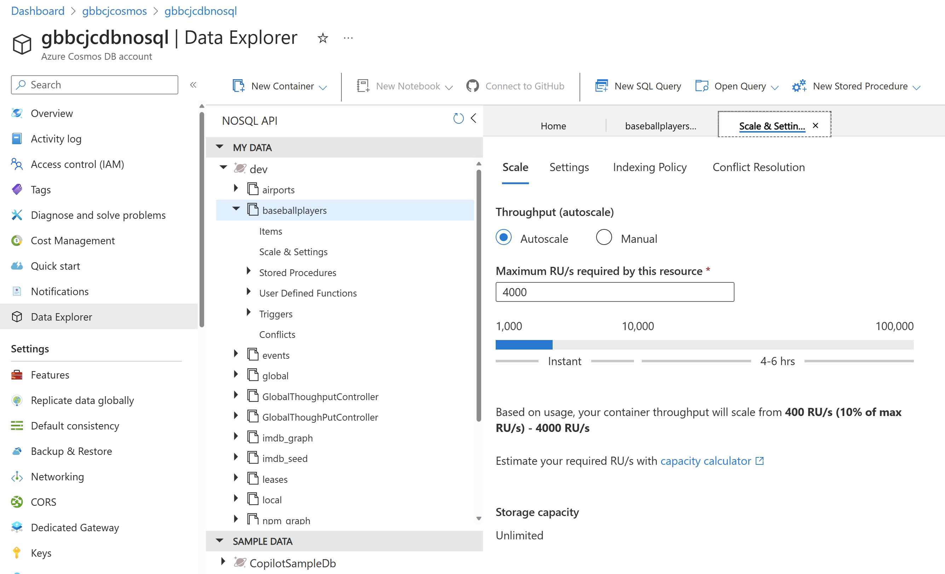
Azure Cosmos DB : Request Units and Autoscale

Slide 7
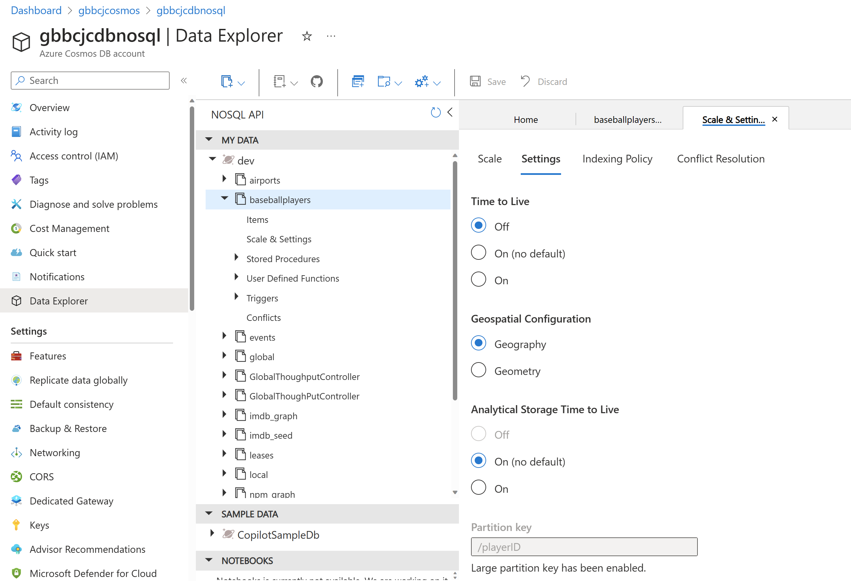
Azure Cosmos DB : TTL, Synapse Link, Partition Key Configuration

Slide 8
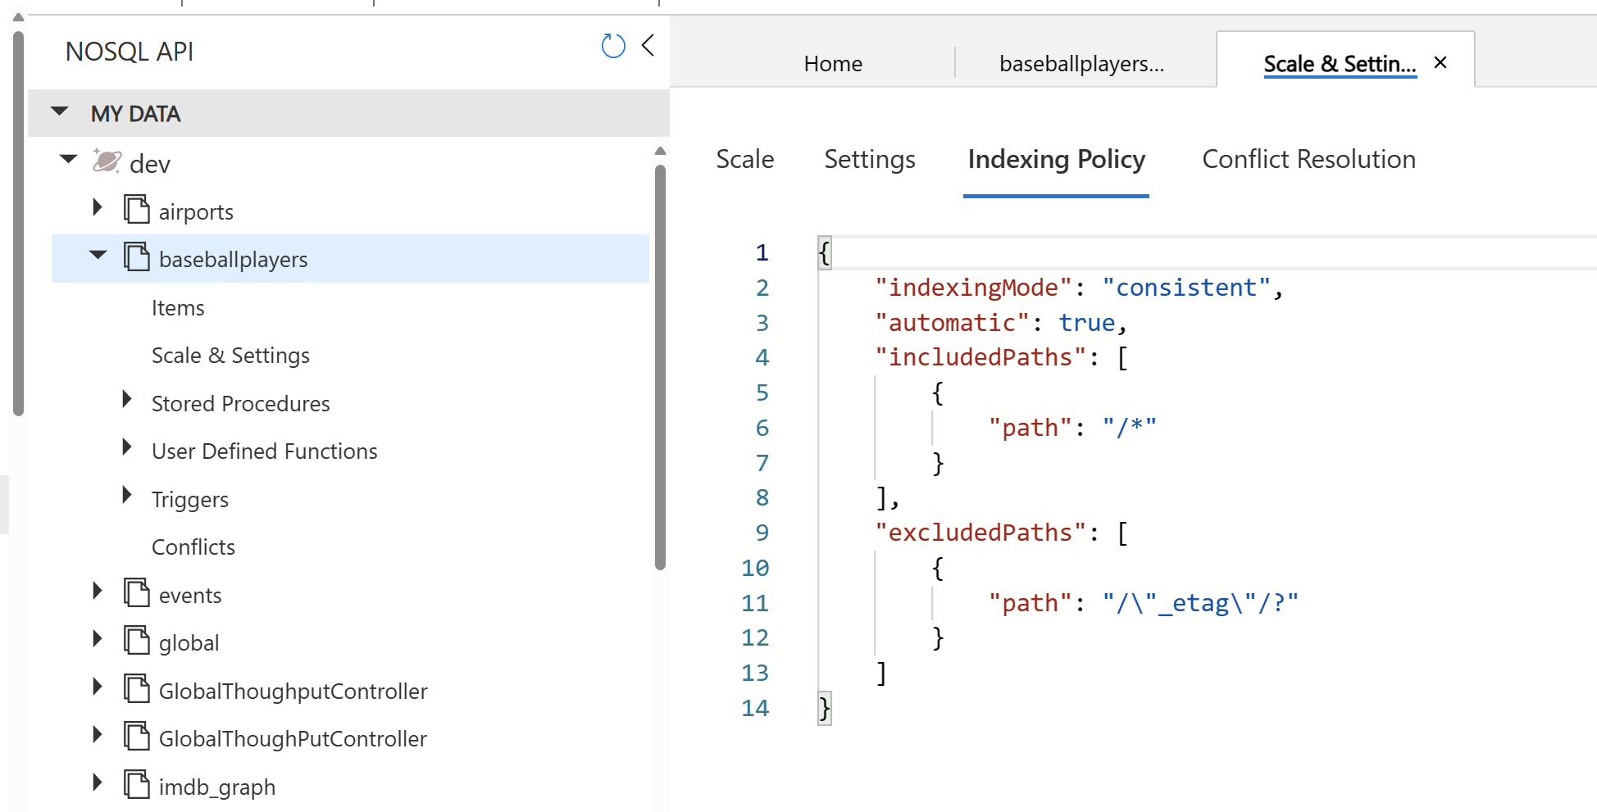
Azure Cosmos DB : Indexing – Defined with JSON, Defaults to /*

Slide 9
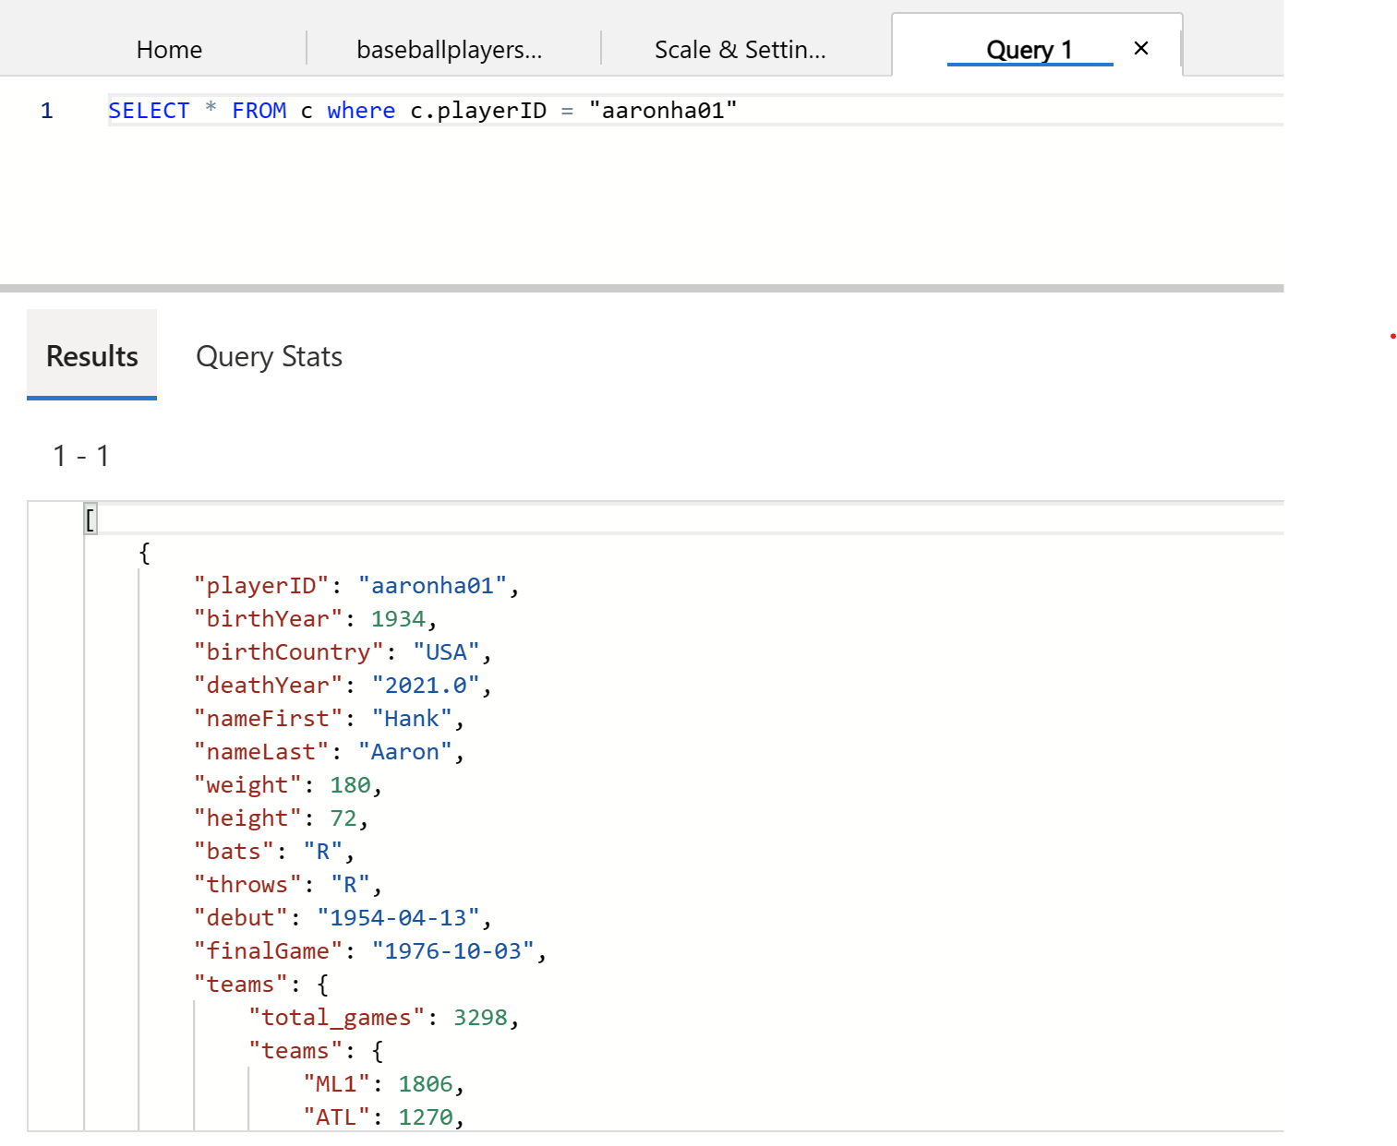
Azure Cosmos DB : Query with SQL

Slide 10
The Azure Cosmos DB JavaScript/TypeScript SDK
https://github.com/Azure/azure-sdk-for-js
https://github.com/Azure/azure-sdk-for-js/tree/main/sdk/cosmosdb/cosmos
https://www.npmjs.com/package/@azure/cosmos
The Cosmos DB JavaScript SDK is part of the Azure JavaScript SDK
It is written in TypeScript, and is transpiled into JavaScript
Current Version is 4.0.0 – adds excellent features
Throughput Control, Hierarchical Partition keys, Async
Supports Asynchronous Operations – await/async
npm install @azure/cosmos
Other Links:
https://learn.microsoft.com/en-us/javascript/api/overview/azure/cosmos-readme?view=azure-node-latest
https://learn.microsoft.com/en-us/samples/azure/azure-sdk-for-js/cosmos-typescript/

Slide 11
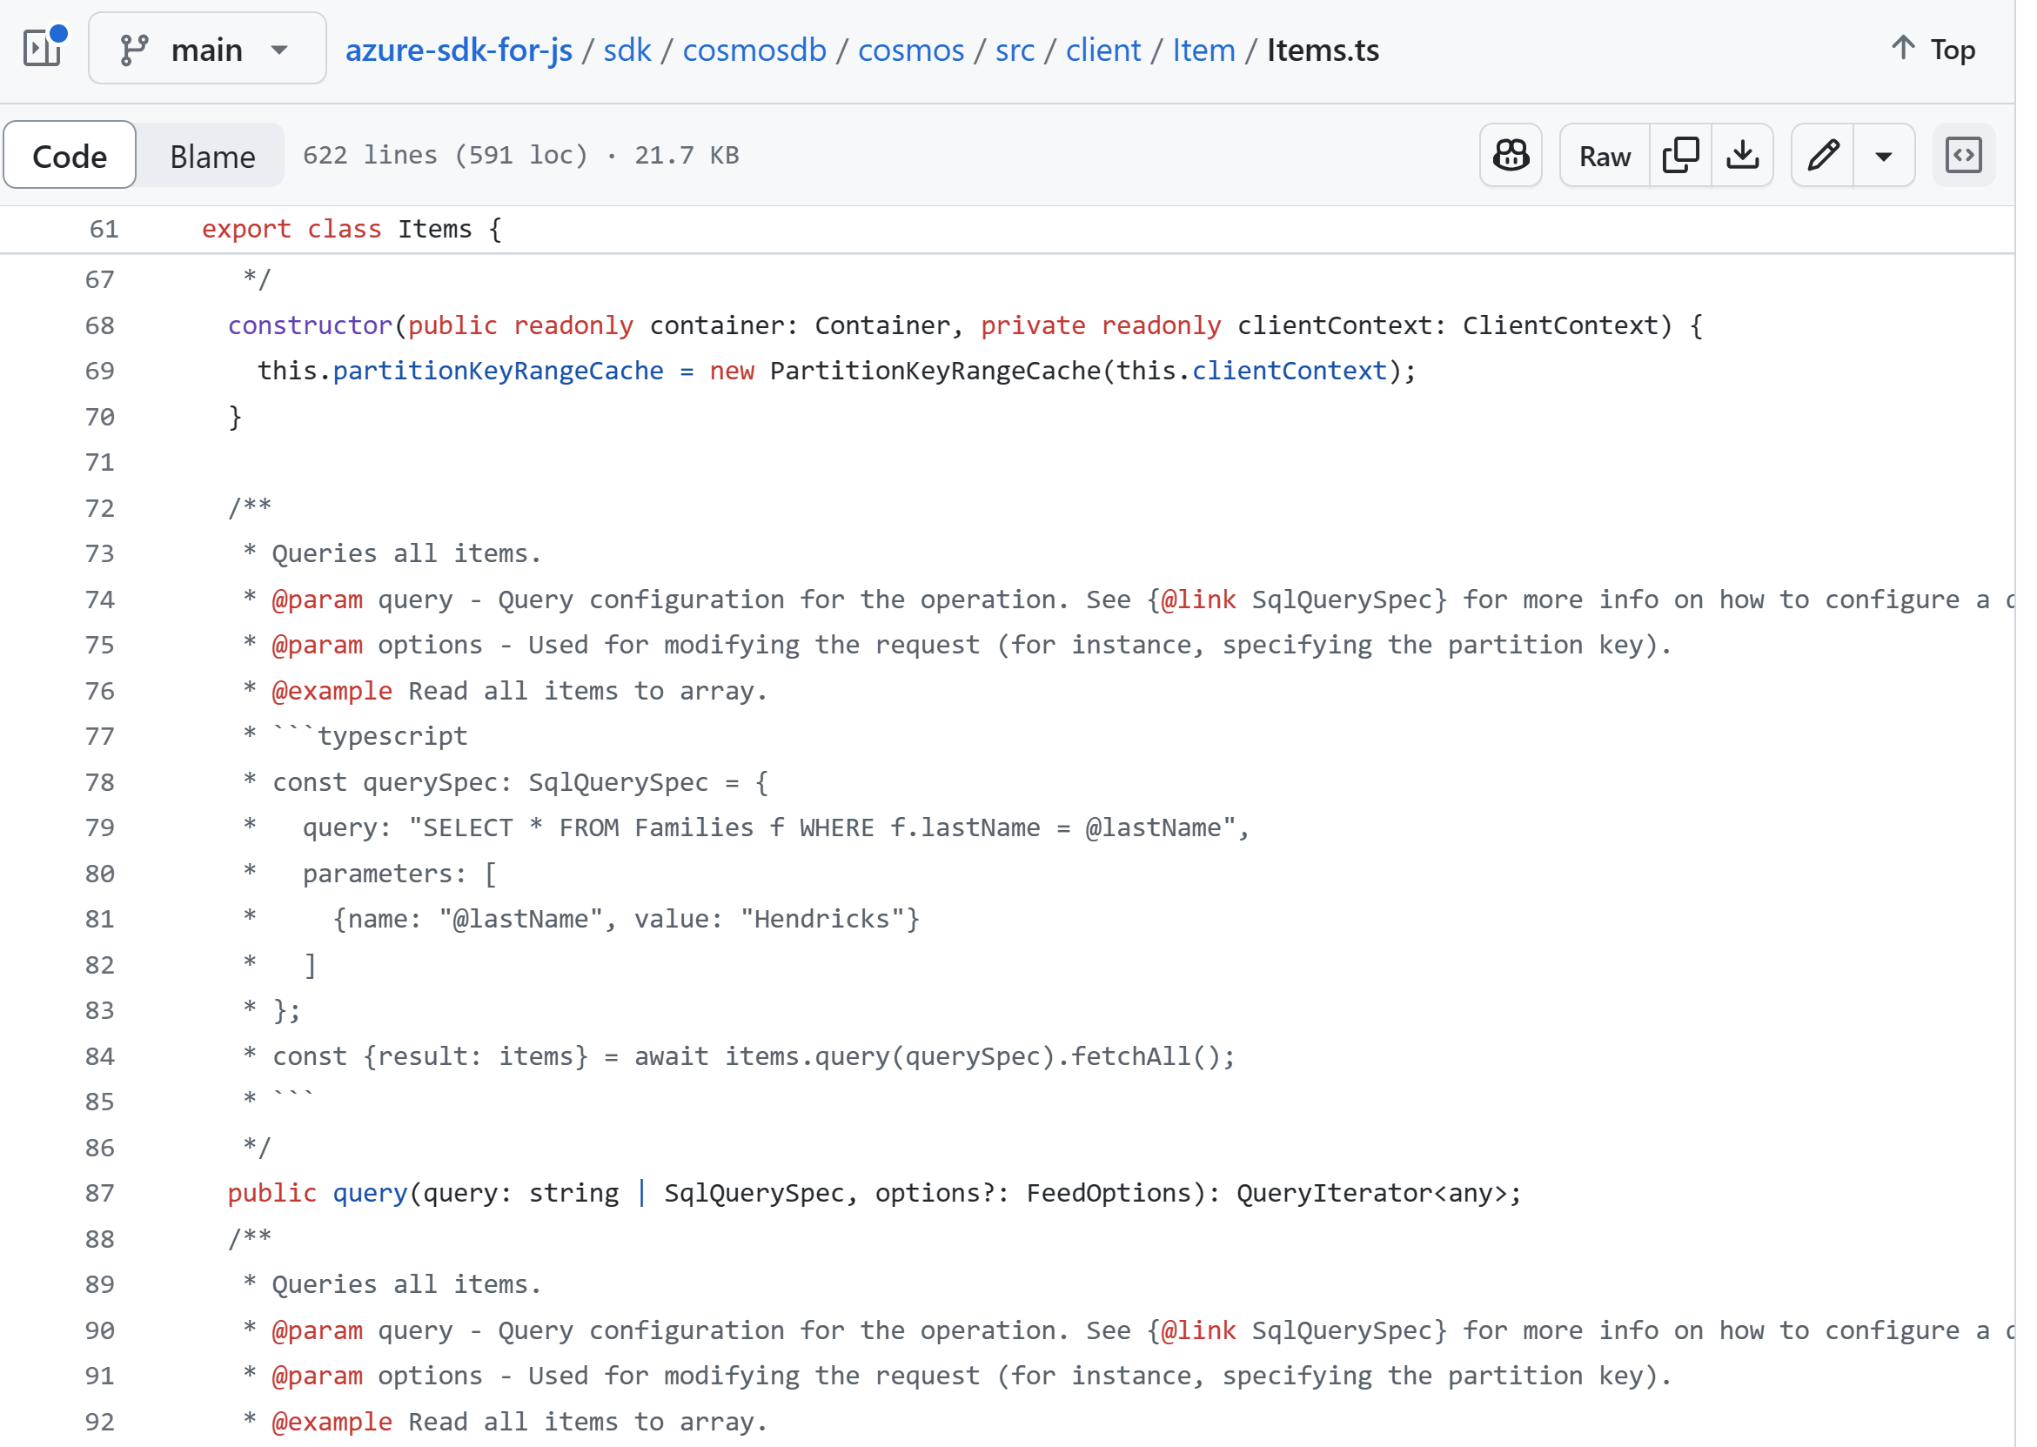
SDK Code on GitHub

Slide 12
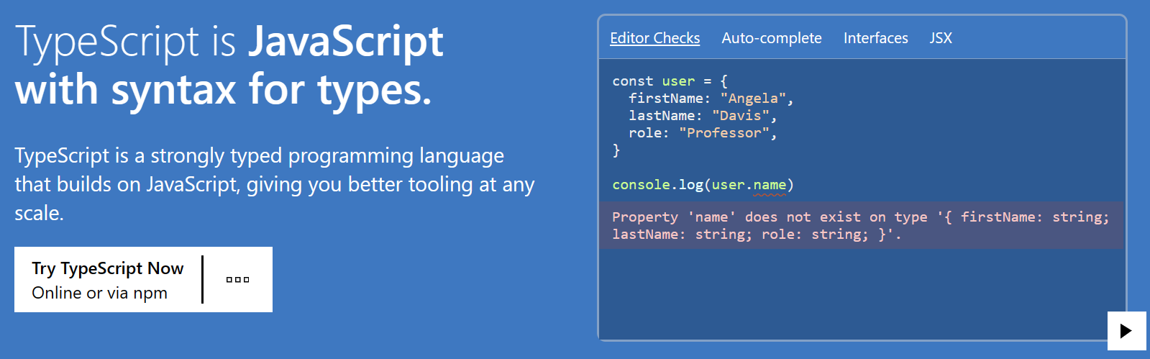
Why TypeScript?
https://www.typescriptlang.org/
Type Safety, High Quality, and High Productivity!

Slide 13
Why TypeScript?
Development
Author your Code as TypeScript (with types, *.ts)
“Transpile” the *.ts into regular JavaScript with the tsc program
Catch many coding errors during development, not deployment
Great IDE Support – Visual Studio Code and GitHub Copilot
Deployment
At runtime it’s just the JavaScript that executes (*.js), all types are eliminated
The Node.js runtime is performant, mature, lightweight
Excellent for Docker Containers and Microservices
Azure Kubernetes Service (AKS), Azure Container Instances (ACI),
Azure Functions, Azure Container Apps (ACA)

Slide 14
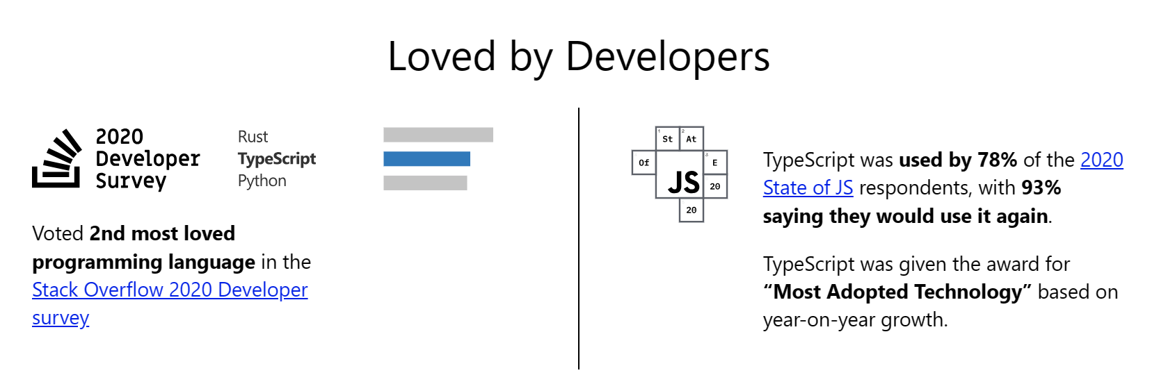
Why TypeScript? Open-Source, Loved, Excellent Docs, Easy to Learn
Open-Source, created and developed by Microsoft
https://www.typescriptlang.org/docs/
Type Safety and High Productivity!

Slide 15
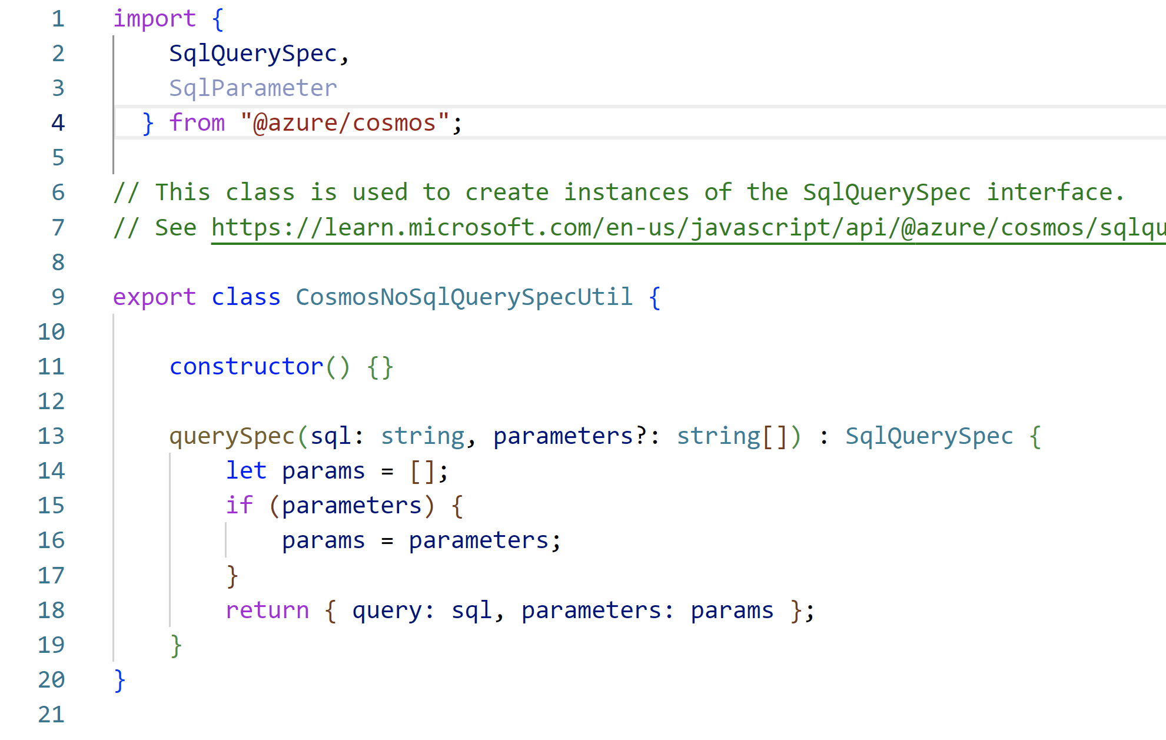
TypeScript: What does it look like?
Items of note:
- import/export statements
- classes
- constructor
- method args with types
- optional args with ?
- return type defined
- use of duck-type interfaces
- also public/private/static
- tsc compiler will complain

Slide 16
The azu-js Package @ NPM
Provides an easy to use wrapper for some Azure SDK functions
Azure Cosmos DB NoSQL API
Azure Blob Storage
Azure Cognitive Search (now Azure AI Search)
Azure OpenAI
Also File System, Config, Logging
Provides easy to find samples of the Cosmos DB JS SDK
I use it for my many TypeScript & Cosmos DB projects
Includes Unit Tests using the Jest test framework
The Unit Tests also provide code examples
https://www.npmjs.com/package/azu-js

Slide 17
The TypeScript/Express/Cosmos DB Web Application : Code
https://github.com/cjoakim/azure-cosmos-db-ts-web
This repo provides a working demonstration application
As well as a “starter codebase” for developing your own apps
Also in the repo:
Dockerfile for building a container
compose-up and compose-down scripts for Docker Compose
Az CLI provisioning script to deploy container to ACI
See https://www.npmjs.com/package/tsg-js for a minimal “scaffolding code generator” like in Ruby on Rails

Slide 18
The TypeScript/Express/Cosmos DB Web Application : Code
index.ts entry point – using the Express Web Framework
https://github.com/cjoakim/azure-cosmos-db-ts-web/blob/main/src/IndexRouter.ts
CosmosRouter.ts – uses the azu-js package
https://github.com/cjoakim/azure-cosmos-db-ts-web/blob/main/src/CosmosRouter.ts
ejs HTML templates in the views/ directory
https://github.com/cjoakim/azure-cosmos-db-ts-web/tree/main/views
package.json – defines the Node.js project and NPM dependencies
tsconfig.json – defines the behavior of the tsc transpiler program
web.ps1 and web.sh – scripts to start the application on Developer workstation

Slide 19
The TypeScript/Express/Cosmos DB Web Application : Demo
See the live or recorded demo,
or the screen shots on the following pages
Or, deploy it yourself using the az CLI deployment script in this repo in the az/ directory
az/provision-webapp-aci-prod.ps1
DockerHub image:
cjoakim/azure-cosmos-db-ts-web-prod:latest

Slide 20
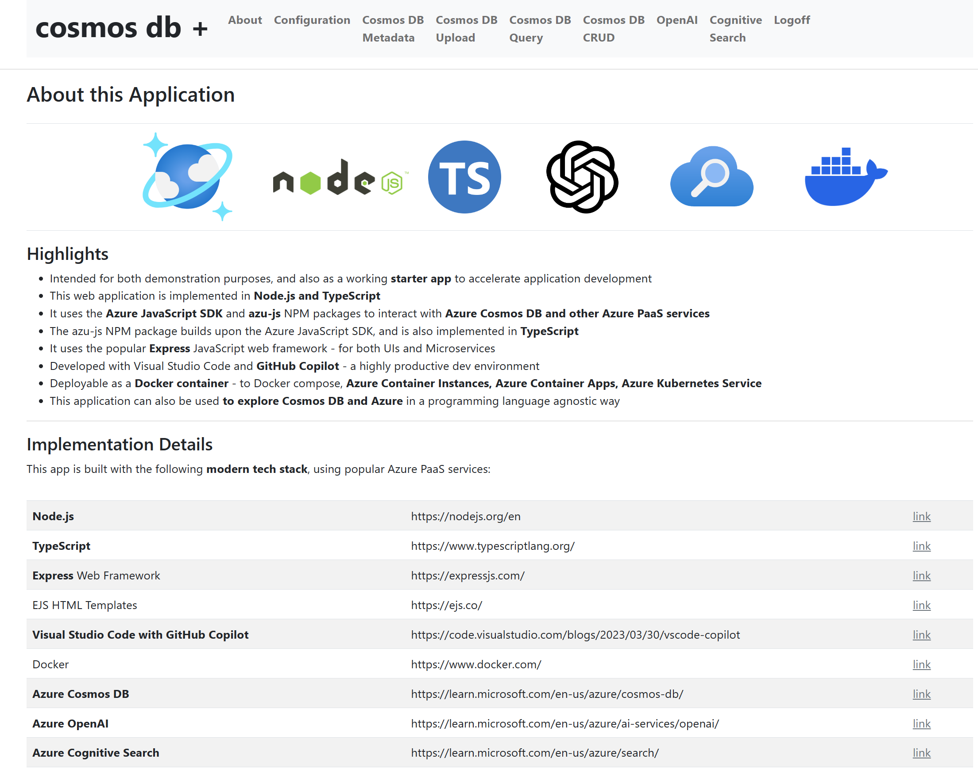
Web App Screen Shots : About

Slide 21
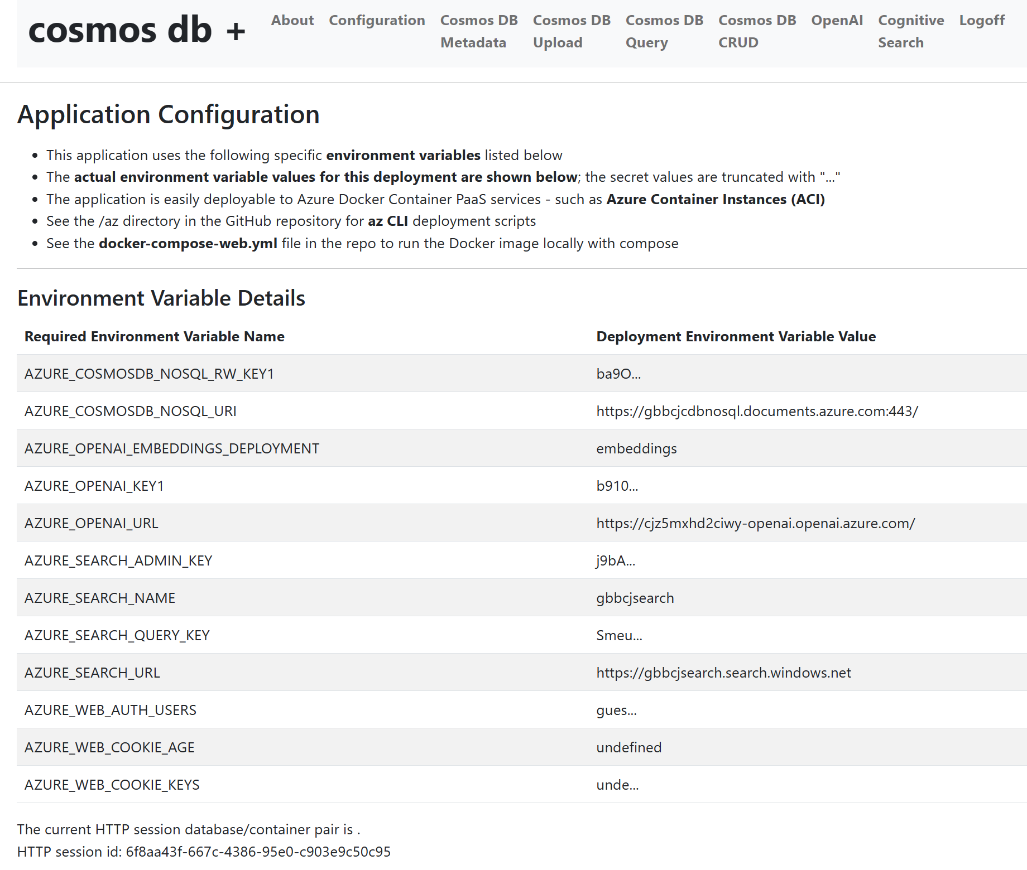
Web App Screen Shots : Configuration

Slide 22
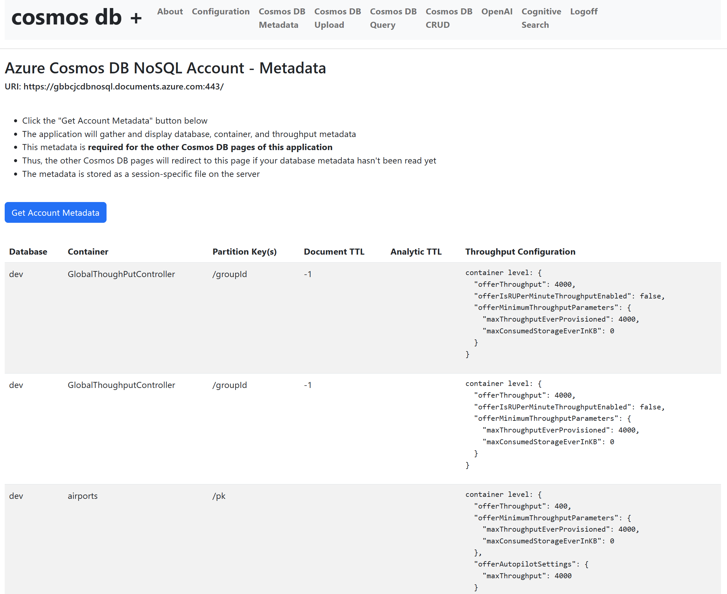
Web App Screen Shots : Cosmos DB Metadata

Slide 23
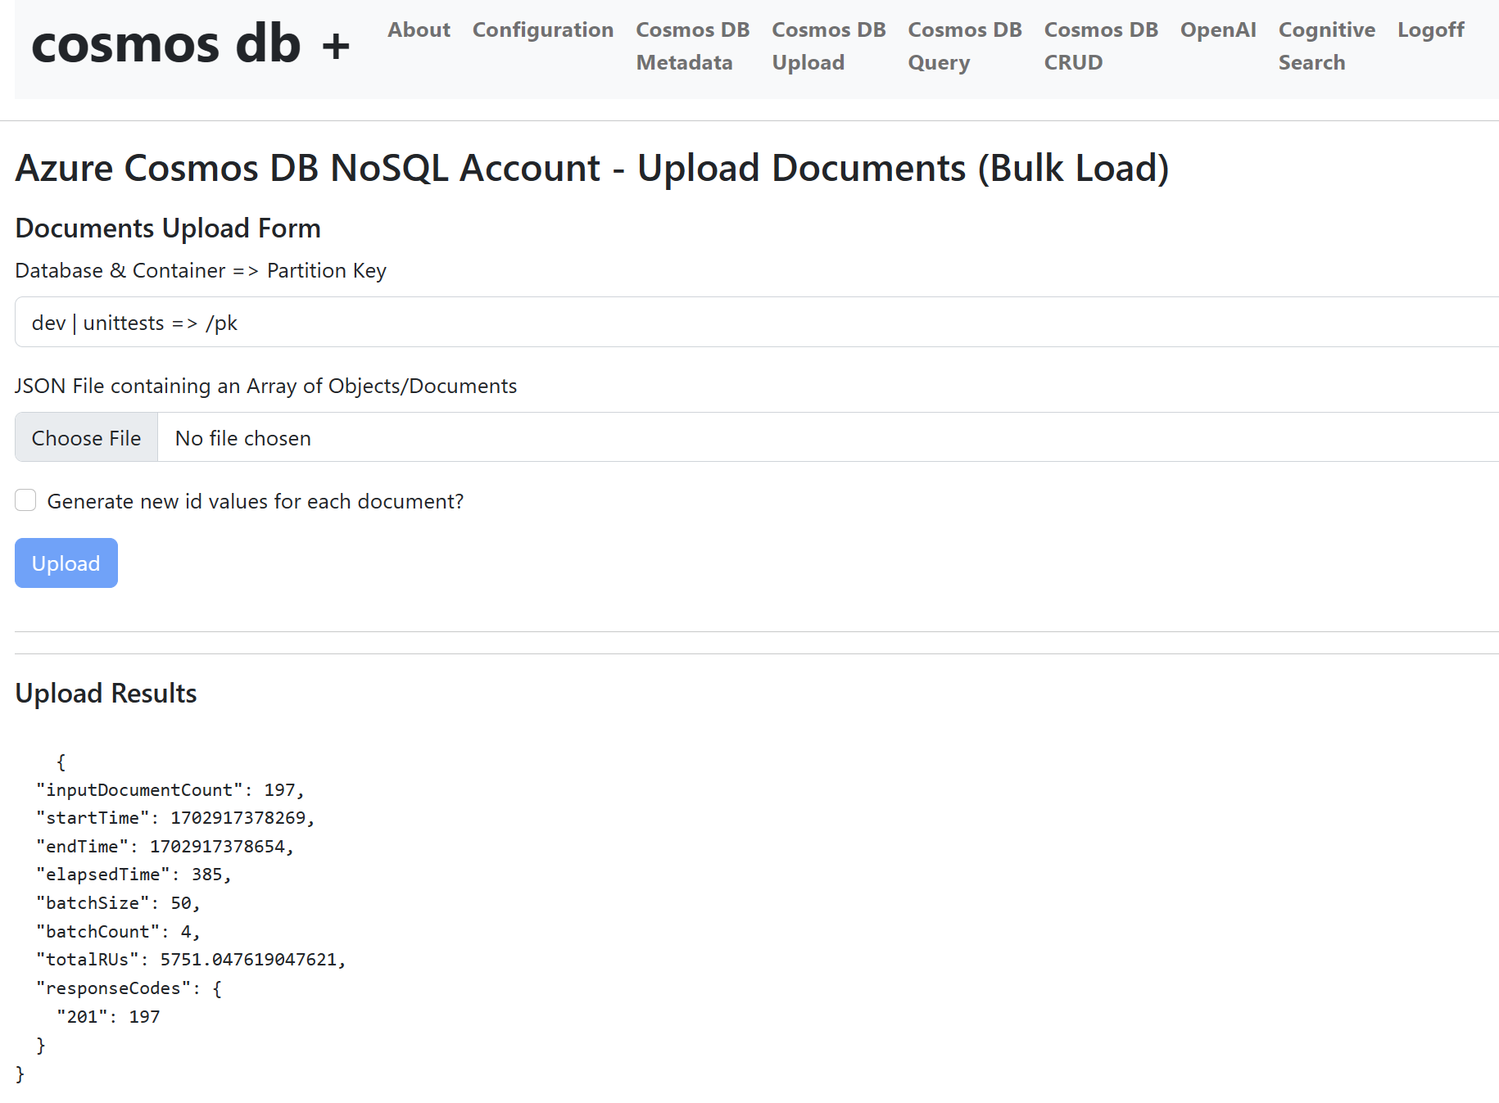
Web App Screen Shots : Cosmos DB JSON File Upload

Slide 24
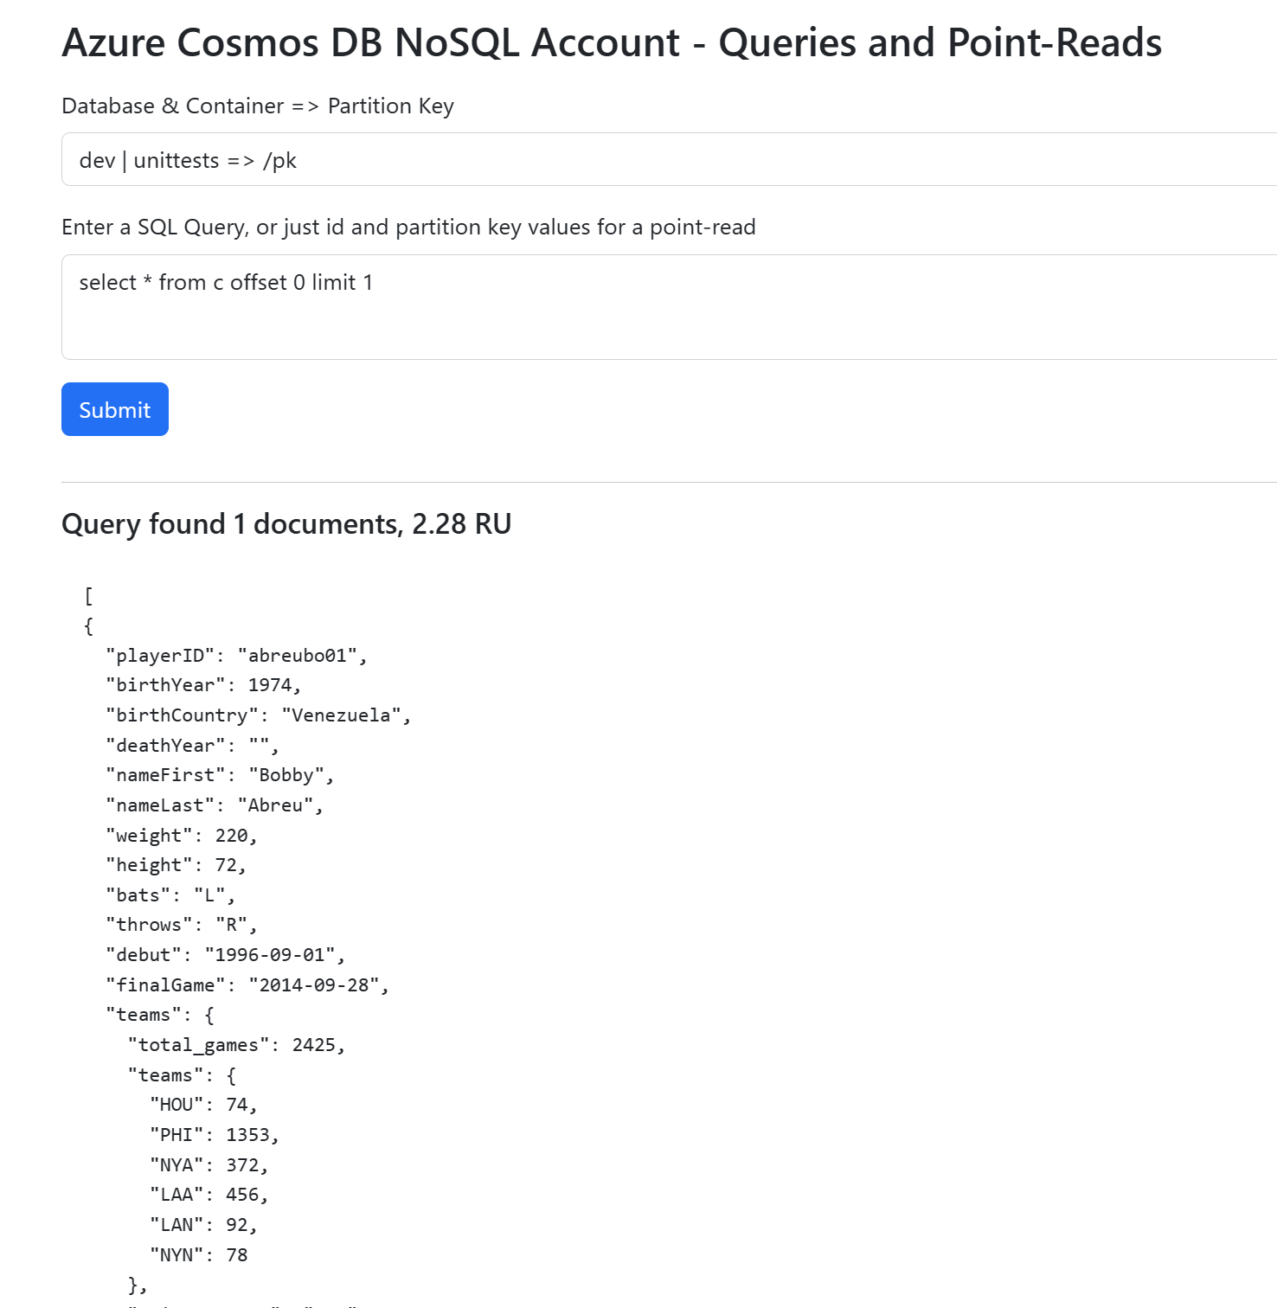
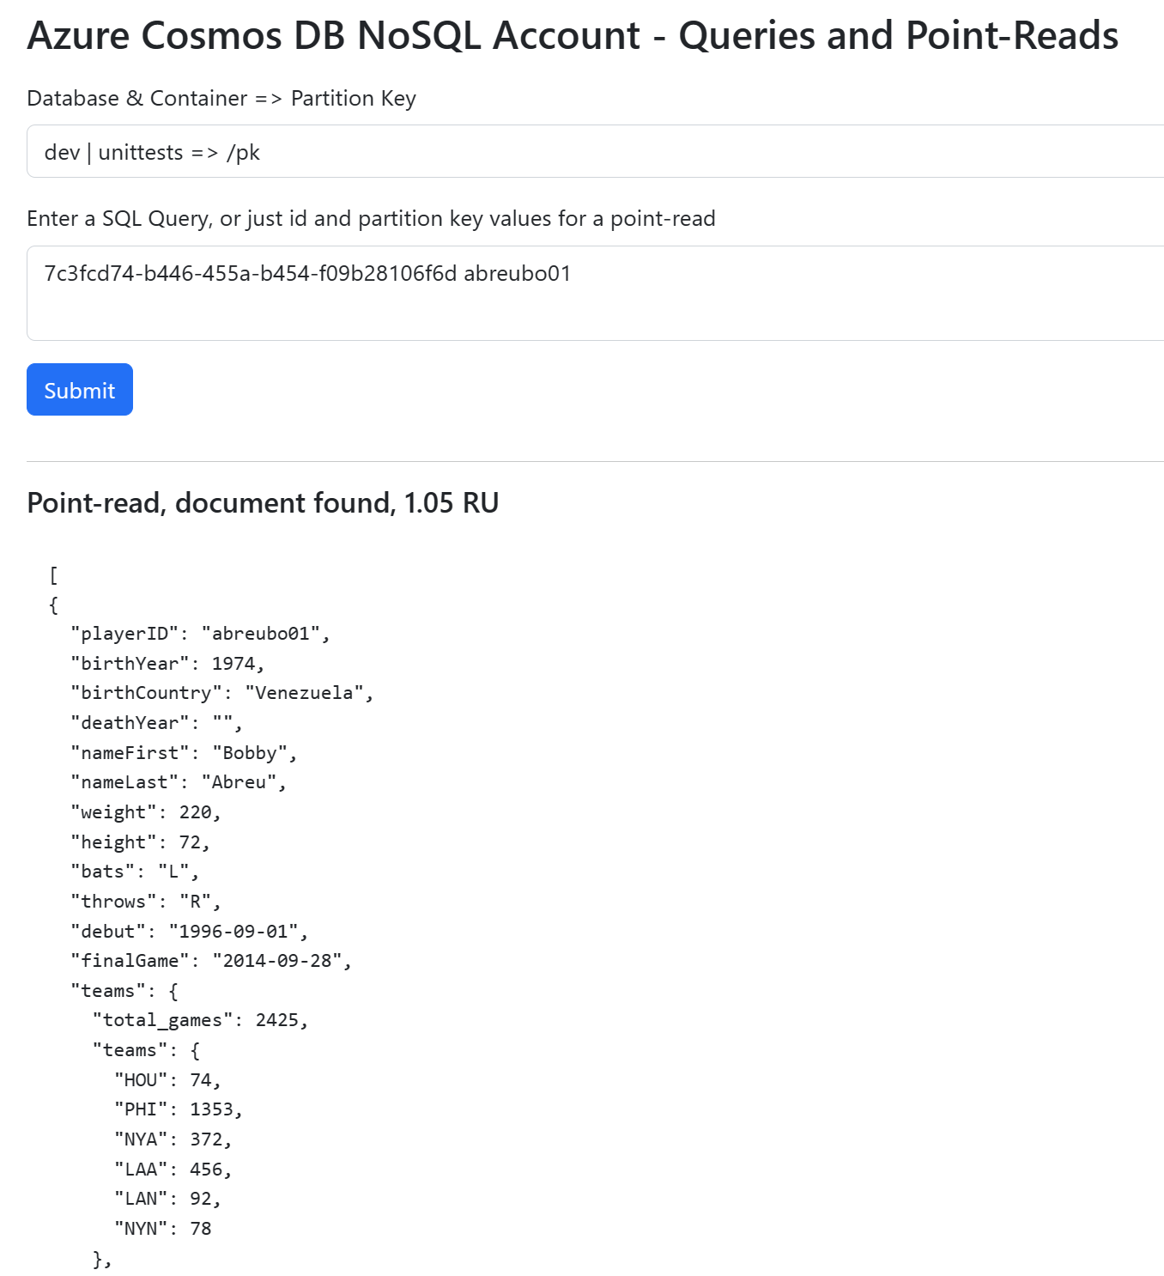
Web App Screen Shots : Queries and Point Reads

Slide 25
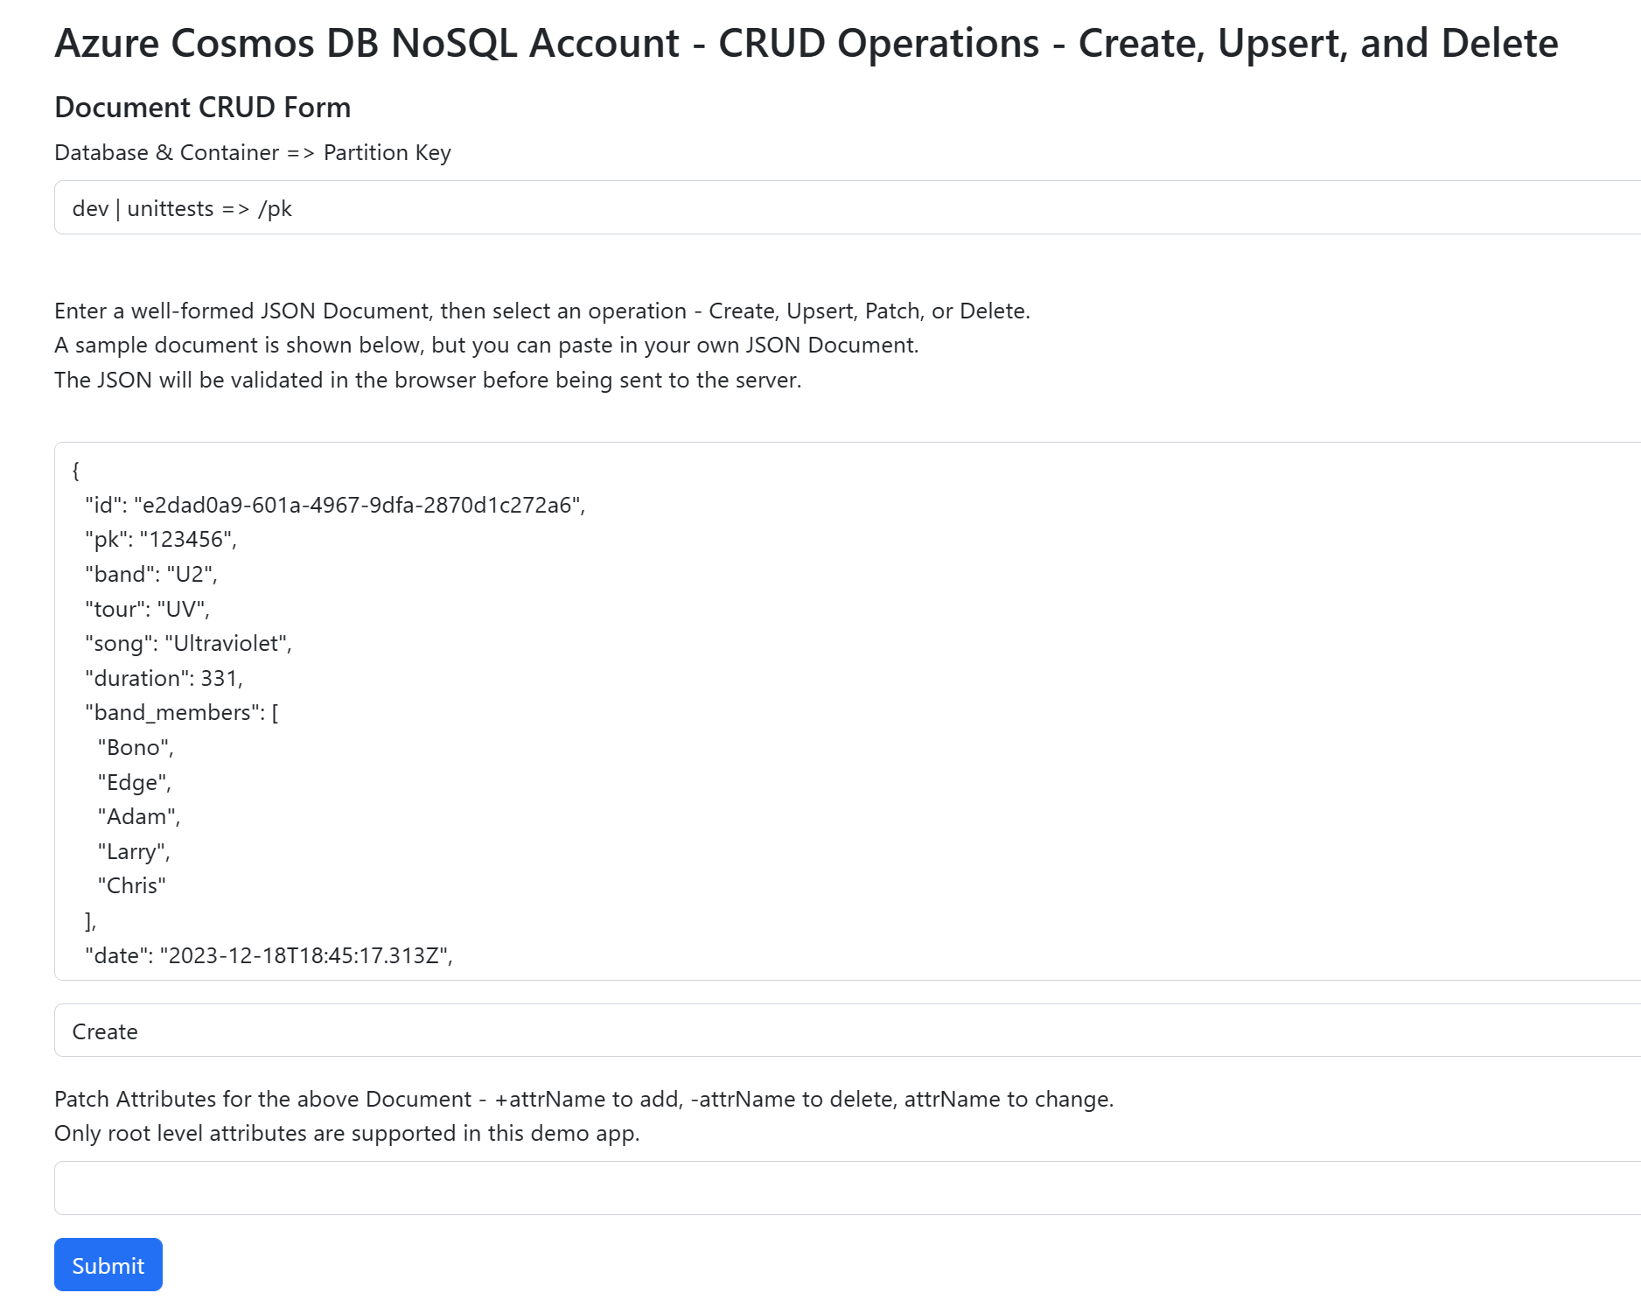
Web App Screen Shots : CRUD operations, including Patch

Slide 26
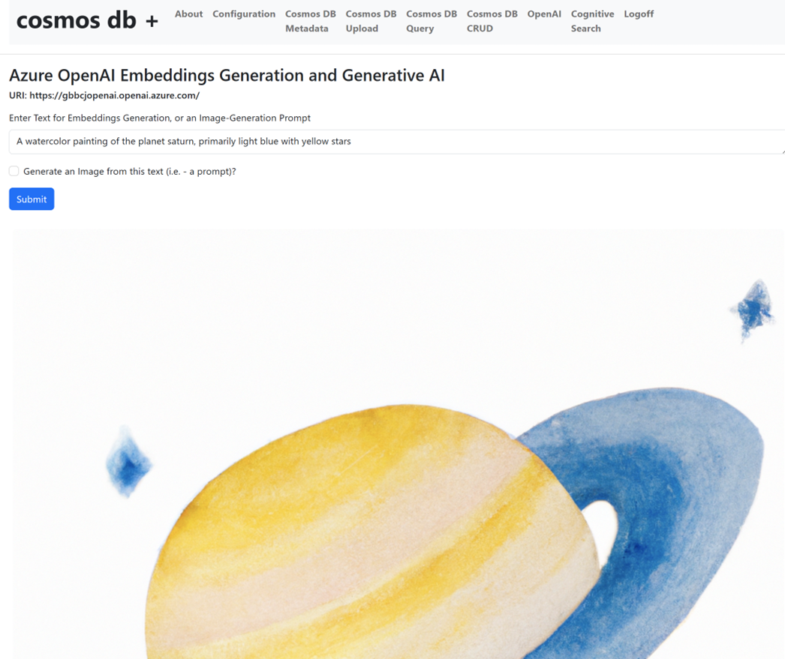
Web App Screen Shots : OpenAI Integration

Slide 27
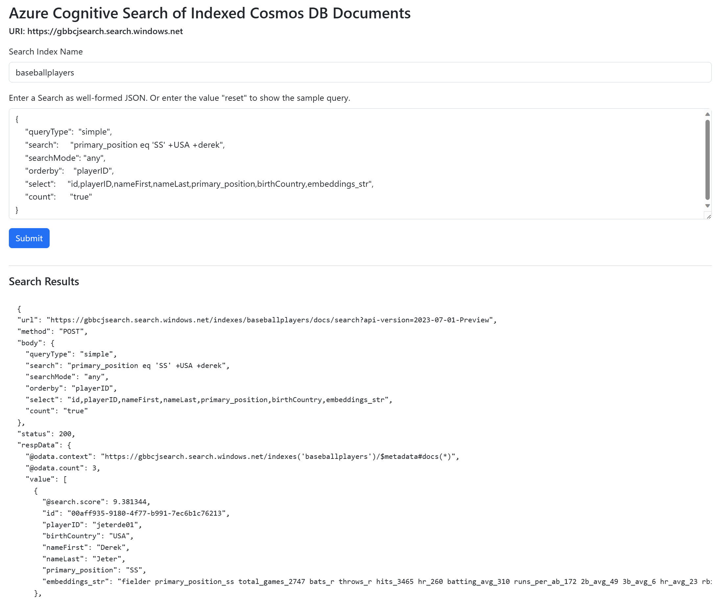
Web App Screen Shots : Cognitive Search (now AI Search)

Slide 28
Summary
Cosmos DB is a high performance, highly available, distributed, JSON-based NoSQL database that allows for low costs due to the Request Unit cost model
TypeScript is a high-productivity programming language that transpiles to regular JavaScript
The Azure Cosmos DB SDKs provide excellent support as well as modern features such as Asynchronous processing
The azu-js NPM library provides an easy-to-use SDK wrapper as well as code examples for using the SDK
Node.js is a very performant runtime environment
Azure has multiple deployment options for TS/JS apps
https://github.com/cjoakim/azure-cosmos-db-ts-web provides a “starter app codebase” for your use

Slide 29
Thank you!
Questions?

